Slide 1
Design and Analysis of Algorithms
CS602
Lecture 22
Amortized analysis - II

Slide 2
RECAP of Last Lecture

Slide 3


The Problem
time taken by operation
$$f(n)$$
$$f(n)$$
Operations
Operations taking less time
Operation taking huge time

Slide 4
Amortized Analysis

Slide 5
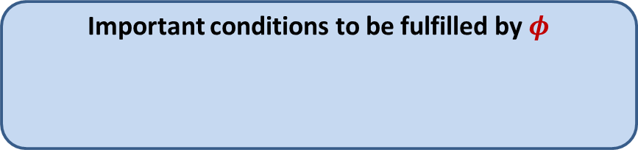




Amortized Cost
$φ$: potential function associated with the algorithm/data-structure
$φ(i)$: Potential at the end of $i$th operation
Amortized cost of $i$th operation $≝$ Actual cost of $i$th operation
Amortized cost of $n$ operations $≥$ Actual cost of $n$operations
Important conditions to be fulfilled by $φ$
$φ(0)$ = $0$
$φ\left(i\right)≥0$ for all $i$
+ $\left(φ\left(i\right)−φ\left(i−1\right)\right)$

Slide 6


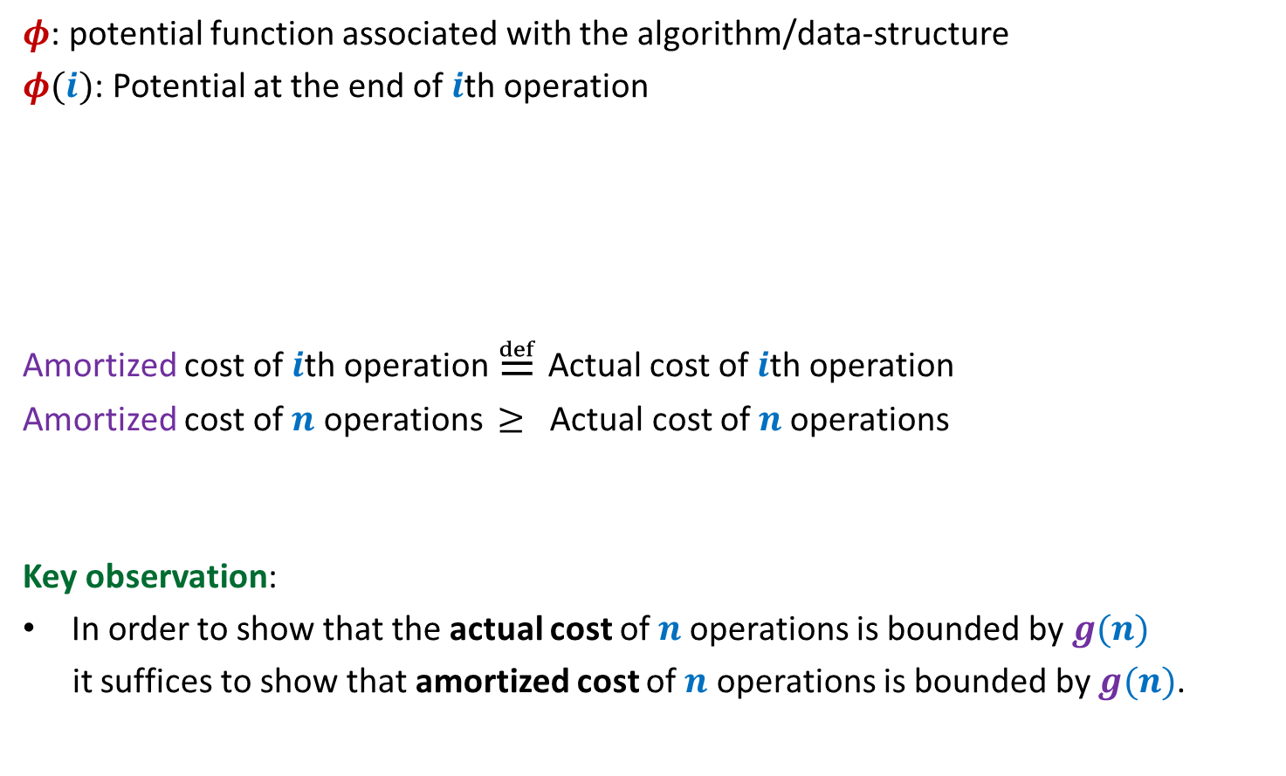
Amortized Cost
$φ$: potential function associated with the algorithm/data-structure
$φ(i)$: Potential at the end of $i$th operation
Amortized cost of $i$th operation $≝$ Actual cost of $i$th operation
Amortized cost of $n$ operations $≥$ Actual cost of $n$operations
Key observation:
In order to show that the actual cost of $n$operations is bounded by $g(n)$
it suffices to show that amortized cost of $n$ operations is bounded by $g(n)$.
Important conditions to be fulfilled by $φ$
$φ(0)$ = $0$
$φ\left(i\right)≥0$ for all $i$
+ $\left(φ\left(i\right)−φ\left(i−1\right)\right)$
$=O(g(n)$)
?
$O(g(n)$)

Slide 7


This is how it may work out
Actual cost
Amortized
cost
Amortized
cost
$$Δφ$$
+
+
+
+
+
+
Operations
Amortized cost
$$−$$
$$−$$
$$−$$
$$−$$
Operations taking less time
Operation taking huge time
Operations

Slide 8
This is how it may work out
Actual cost
$$Δφ$$
+
+
+
+
+
+
Operations
Amortized cost
$$−$$
$$−$$
$$−$$
Amortized
Cost of all operations
Operations

Slide 9
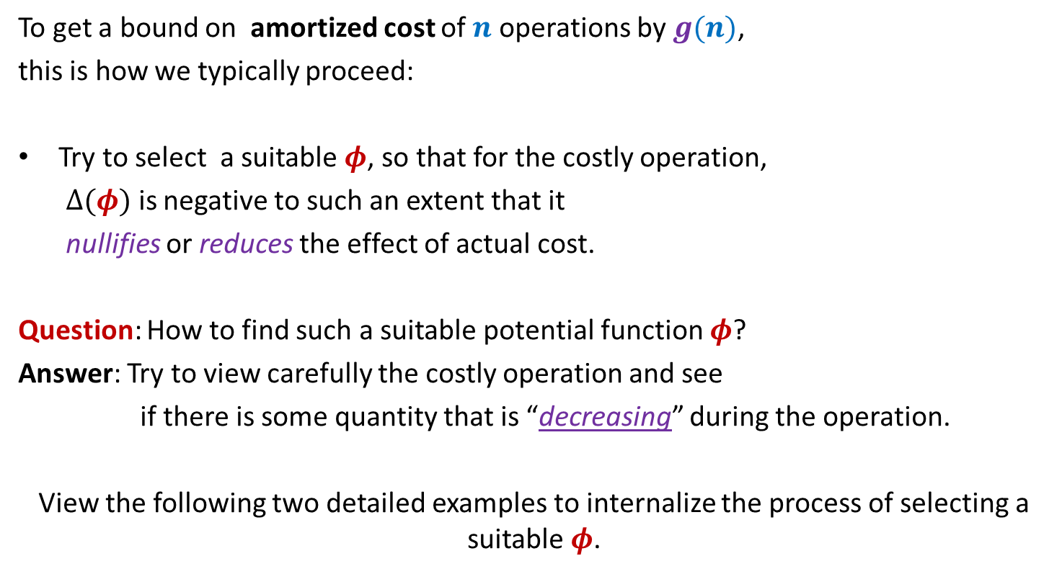
Amortized Cost
To get a bound on amortized cost of $n$ operations by $g(n)$,
this is how we typically proceed:
Try to select a suitable $φ$, so that for the costly operation,
$Δ(φ)$ is negative to such an extent that it
nullifies or reduces the effect of actual cost.
Question: How to find such a suitable potential function $φ$?
Answer: Try to view carefully the costly operation and see
if there is some quantity that is “decreasing” during the operation.
View the following two detailed examples to internalize the process of selecting a suitable $φ$.

Slide 10
amortized analysis of Stack with multi-pop

Slide 11



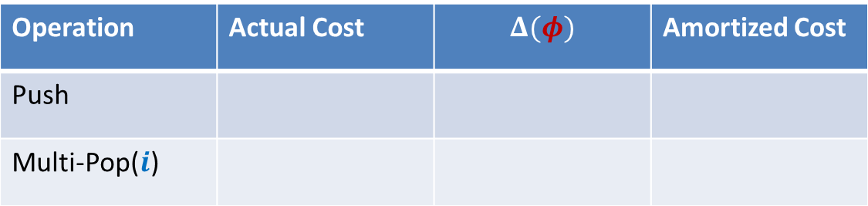






Stack with multi-pop
Multi-pop($S$,$i$)
Top
$i$ elements
$$S$$
$$S$$
Operation | Actual Cost | $$Δ(φ)$$ | Amortized Cost
Push
Multi-Pop($i$)
$$c$$
$$i c$$
$$−i c$$
$$0$$
$φ$($i$): $c$ (# elements in stack after $i$th operation)

Slide 12





Stack with multi-pop
Push($S$,$x$)
$$S$$
$$S$$
Operation | Actual Cost | $$Δ(φ)$$ | Amortized Cost
Push
Multi-Pop($i$)
$$c$$
$$c$$
$$2c$$
$$i c$$
$$−i c$$
$$0$$
$φ$($i$): $c$ (# elements in stack after $i$th operation)
Amortized cost of each operation $≤2c$
Amortized cost of $n$ operations $≤2nc=O(n)$
Actual cost of $n$ operations $=O(n)$

Slide 13
Application 1
Dynamic Tables

Slide 14
Memory Management
What happens if more space is needed by table ?
Table T
Free space
Memory

Slide 15
SPACE and TIME Efficient Dynamic Table
For Insertions Only

Slide 16




Some notations
$n$
createTable($k$):
A system-call that creates a table of size $k$
size($T$)
copy($T$,$T′$)
free($T$)
: number of elements in the table $T$.
and returns its pointer.
: the size of table $T$.
: copies the contents of table $T$ into $T′$.
: free the space (return the space to OS) occupied by table $T$.
The max number of elements to be inserted into Table is not known in advance.

Slide 17
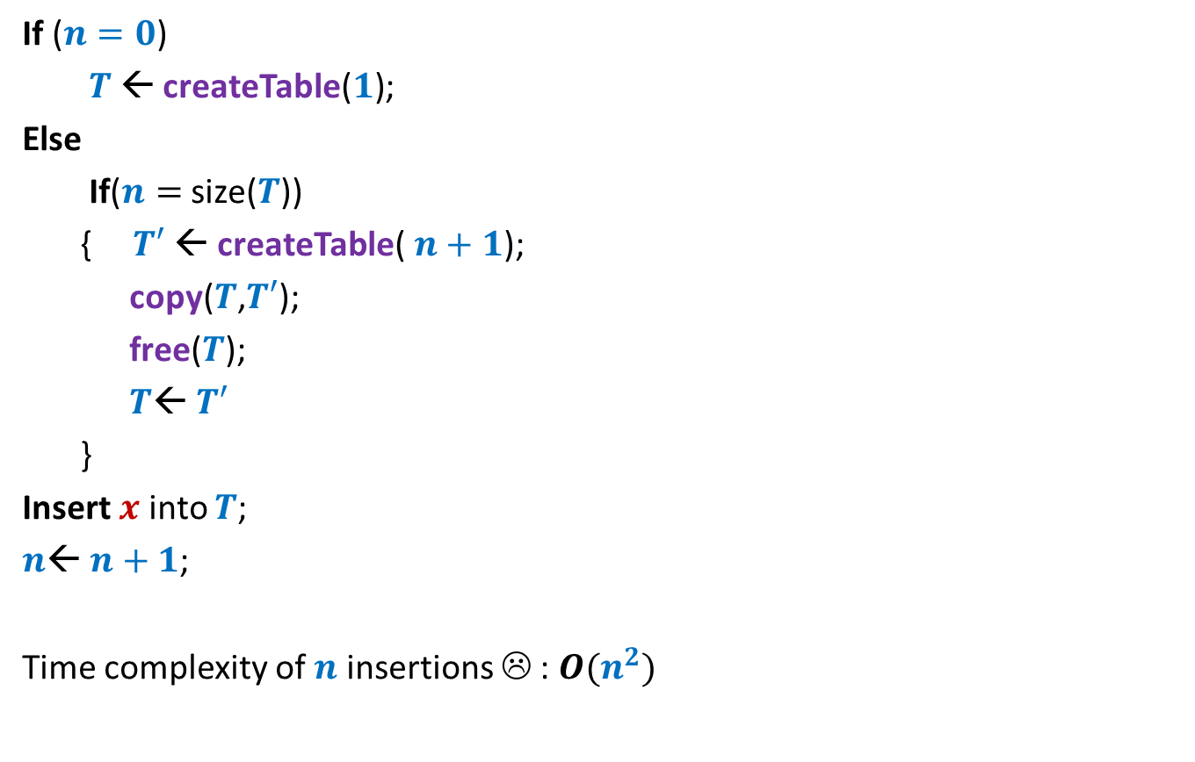




A trivial way to perform Insert($x$)
If ($n=0$)
$T$← createTable($1$);
Else
If($n=$ size($T$))
{ $T′$← createTable($n+1$);
copy($T$,$T′$);
free($T$);
$T$← $T′$
}
Insert $x$ into $T$;
$n$← $n+1$;
Time complexity of $n$ insertions ☹ : $O(n^{2})$
// Table is full !
O($1$)
O($n$)
O($1$)
Idea:
Every time a table is full, create a new table of double the size.

Slide 18






An efficient way to perform Insert($x$)
Space utilization ?
If ($n=0$)
$T$← createTable($1$);
Else
If($n=$ size($T$))
{ $T′$← createTable($n+1$);
copy($T$,$T′$);
free($T$);
$T$← $T′$
}
Insert $x$ into $T$;
$n$← $n+1$;
($2$);
// Table is full !
$$2n$$
O($1$)
O($n$)
O($1$)
Observation:
The table is at least half-full always.
So space utilization is at least 50%.

Slide 19





An efficient way to perform Insert($x$)
Actual cost per insertion
$$17$$
$$9$$
$$5$$
$$3$$
$$1$$
1 | 2 | 3 | 4 | 5 | 6 | 7 | 8 | 9 | 10 | 11 | 12 | 13 | 14 | 15 | 16 | 17 | 18
insertions

Slide 20
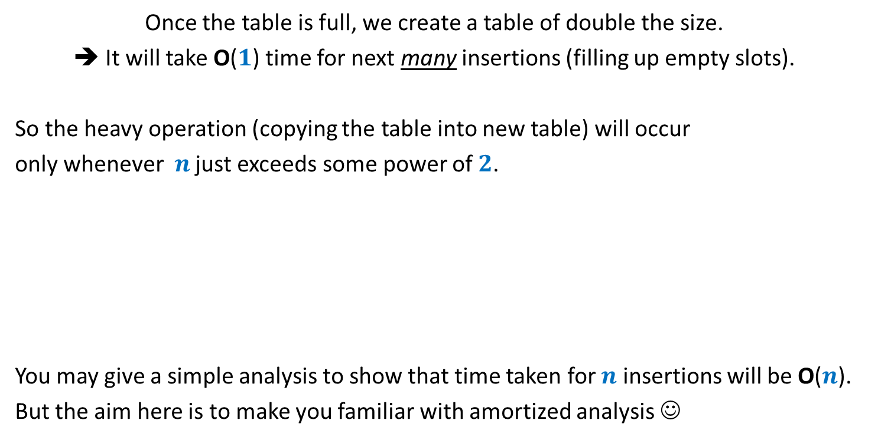
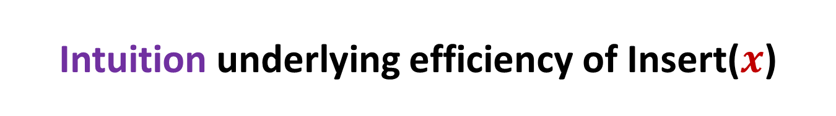
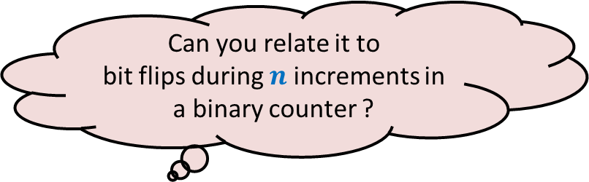
Intuition underlying efficiency of Insert($x$)
Once the table is full, we create a table of double the size.
➔ It will take O($1$) time for next many insertions (filling up empty slots).
So the heavy operation (copying the table into new table) will occur
only whenever $n$ just exceeds some power of $2$.
You may give a simple analysis to show that time taken for $n$ insertions will be O($n$).
But the aim here is to make you familiar with amortized analysis ☺
Can you relate it to
bit flips during $n$ increments in a binary counter ?

Slide 21
















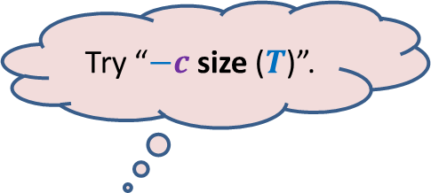
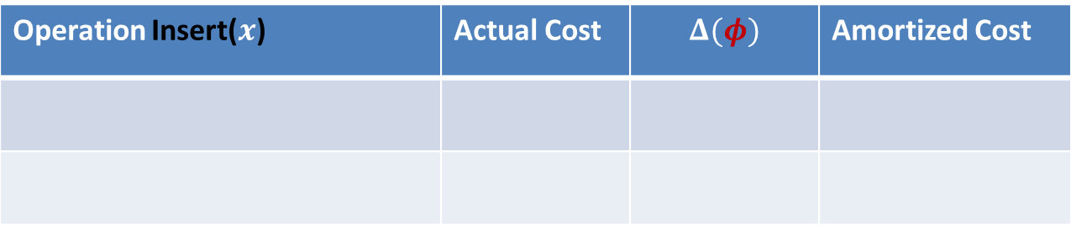


Amortized Analysis of Insert($x$)
$$m$$
$φ$ = $c$ ($m$)
Before Insert($x$)
$$2m$$
$φ$ = $c$ ($2$)
$$x$$
After Insert($x$)
$$m+1$$
Operation Insert($x$) | Actual Cost | $$Δ(φ)$$ | Amortized Cost
Case 1: when table is not full
$$c$$
Case 2: when table is already full
$$cn$$
$$c(2−m)$$
$$c(3−n)$$
$$3c$$
$φ$ at any stage = $c$ ($2n−$ size($T$))
Try “$−c$ size ($T$)”.
It ensures $Δ(φ)$ = $−c(n−1)$ ☺
But $φ$is not non-negative ☹
How to make it non-negative?
Add some positive quantity to make it non-negative.
But what should it be ?
Hint: Use the fact that
the table is at least half-full always.
What should be $φ$ ?
Apparently everything (size or $n$) seems to have increased.☹
Is there anything that has decreased ?
Look carefully the Case 2.

Slide 22



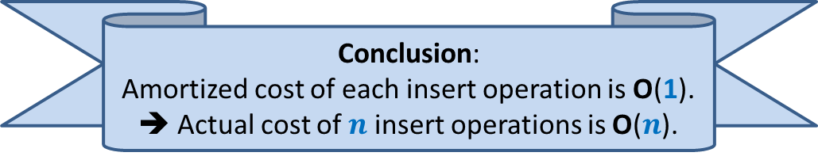
Amortized Analysis of Insert($x$)
Before Insert($x$)
After Insert($x$)
$$x$$
Operation Insert($x$) | Actual Cost | $$Δ(φ)$$ | Amortized Cost
Case 1: when table is not full
$$c$$
$$c(2)$$
$$3c$$
Case 2: when table is already full
$$cn$$
$$c(3−n)$$
$$3c$$
$φ$ at any stage = $c$ ($2n−$ size($T$))
Conclusion:
Amortized cost of each insert operation is O(1).
➔ Actual cost of $n$ insert operations is O($n$).
Analyze Case 1 now.

Slide 23





Amortized Analysis of Insert($x$)
To each element, give $3c$ credits when it is inserted.
$c$ credits for its insertion
$c$ credits for its copying into next table.
$c$ credits for copying one more element into next
Observations: There are always sufficient credits to pay for every operation.
Total number of credits distributed to the operations: $3cn$
➔ Actual cost of $n$ insertions $≤3cn$ = O($n$)
$$x$$
$$x$$
$$x$$

Slide 24
SPACE and TIME Efficient Dynamic Table
For handling deletions only

Slide 25
Sequence of Deletions
Wastage of space !!

Slide 26



An efficient way to perform delete($x$)
Delete $x$ from $T$;
$n$← $n−1$;
If ($n=0$)
free($T$);
Else
If($n=$ size($T$)/2)
{ $T′$← createTable($n$);
copy($T$,$T′$);
free($T$);
$T$← $T′$;
}
// Table is half full !
O($1$)
O($n$)
O($1$)
Observation:
The table is at least half-full always.
So space utilization is at least 50%.

Slide 27
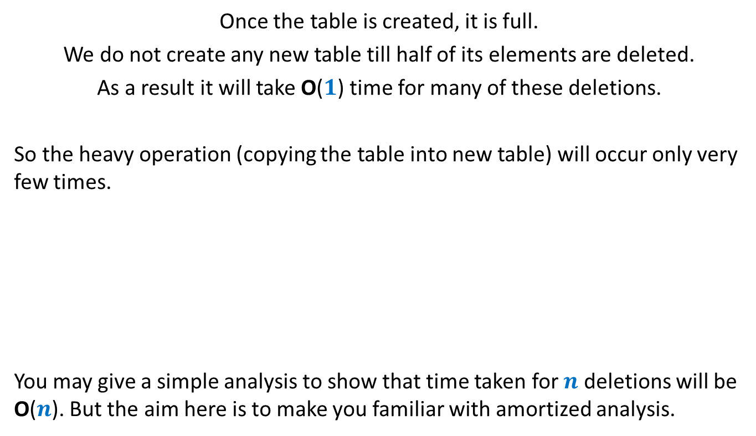
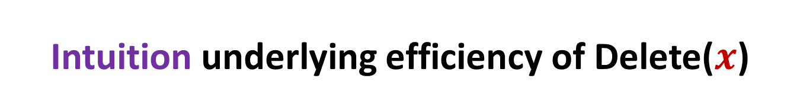
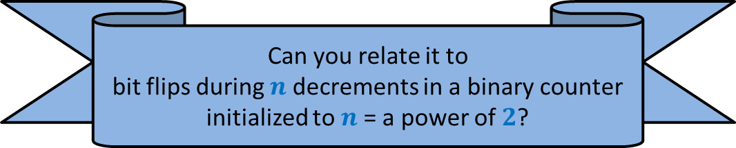
Intuition underlying efficiency of Delete($x$)
Once the table is created, it is full.
We do not create any new table till half of its elements are deleted.
As a result it will take O($1$) time for many of these deletions.
So the heavy operation (copying the table into new table) will occur only very few times.
You may give a simple analysis to show that time taken for $n$ deletions will be O($n$). But the aim here is to make you familiar with amortized analysis.
Can you relate it to
bit flips during $n$ decrements in a binary counter initialized to $n$= a power of $2$?

Slide 28
















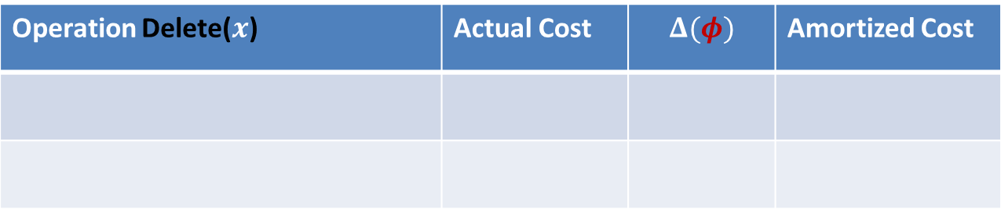



Amortized Analysis of Delete($x$)
$$2m$$
$φ$ = $c$ ($m−1$)
$$x$$
Before Delete($x$)
$$m+1$$
$φ$ = $0$
After Delete($x$)
$$m$$
Operation Delete($x$) | Actual Cost | $$Δ(φ)$$ | Amortized Cost
Case 1: when table does not shrink
$$c$$
$$c$$
$$2c$$
Case 2: when table shrinks to half
$$cn+c$$
$$c(1−n)$$
$$c(1−m)$$
$$2c$$
$φ$ at any stage = $c$ (size($T$)$−n$)
Yes, the number of empty slots has decreased in the table. ☺
So try it as a $φ$.
How can you express number of empty slots in terms of size and $n$ ?
Look carefully at the Case 2.
Is there anything that has decreased ?
What should be $φ$ ?

Slide 29

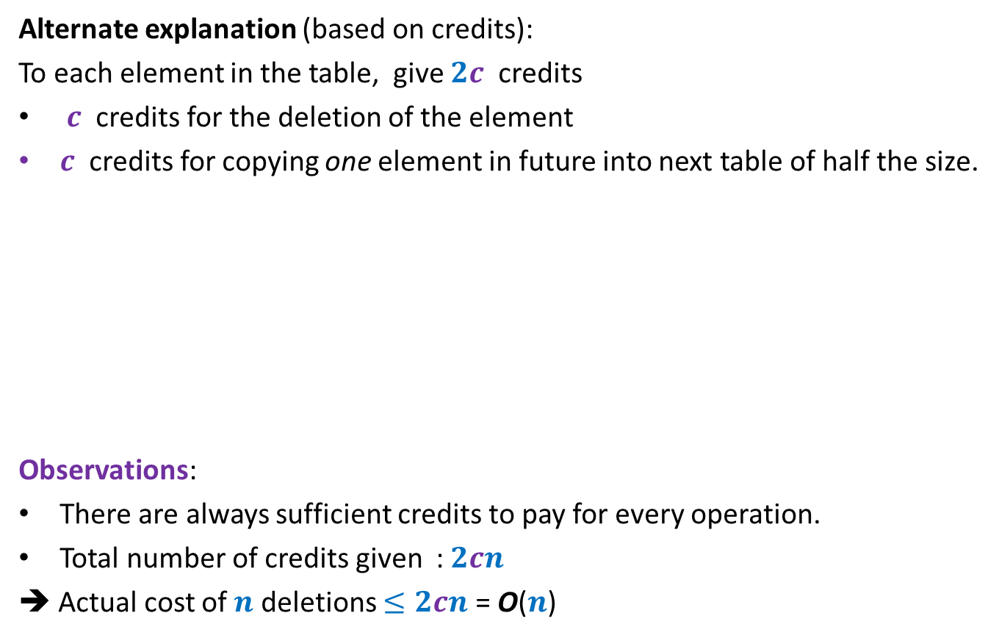
Amortized Analysis of Delete($x$)
Alternate explanation (based on credits):
To each element in the table, give $2c$ credits
$c$ credits for the deletion of the element
$c$ credits for copying one element in future into next table of half the size.
Observations:
There are always sufficient credits to pay for every operation.
Total number of credits given : $2cn$
➔ Actual cost of $n$ deletions $≤2cn$ = O($n$)
Operation Delete($x$) | Actual Cost | $$Δ(φ)$$ | Amortized Cost
Case 1: when table does not shrink
$$c$$
$$c$$
$$2c$$
Case 2: when table shrinks to half
$$cn+c$$
$$c(1−n)$$
$$2c$$

Slide 30
SPACE and TIME Efficient Dynamic Table
For handling insertions and deletions both

Slide 31






Attempt 1
“just use the insertion/deletion procedures since we spent so much time on them”.
there is a serious problem in this combination
$$2m$$
$$x$$
$$m+1$$
Delete($x$)
Each operation requires $Θ(m)$ time ☹
Insert($x$)
$$m$$

Slide 32



An efficient way to perform delete($x$)
Delete $x$ into $T$;
$n$← $n−1$;
If ($n=0$)
FreeTable($T$);
Else
If($n=$ size($T$)/2 )
{ $T′$← CreateTable($n$);
Copy($T$,$T′$);
FreeTable($T$);
$T$← $T′$;
}
size($T$)/4
// Table is quarter full !
($2n$);
O($1$)
O($n$)
O($1$)
Idea:
Delay the shrinking

Slide 33


The intuition behind the new algorithm
Observation: Every time a table is created, it is half-full.
Only two big events can happen in future:
It becomes full
It becomes quarter full
➔ At least $n$ insertions
➔ At least $n/2$ deletions

Slide 34
Homework
Think of a suitable potential function to show that the amortized cost of each operation is constant.

Slide 35
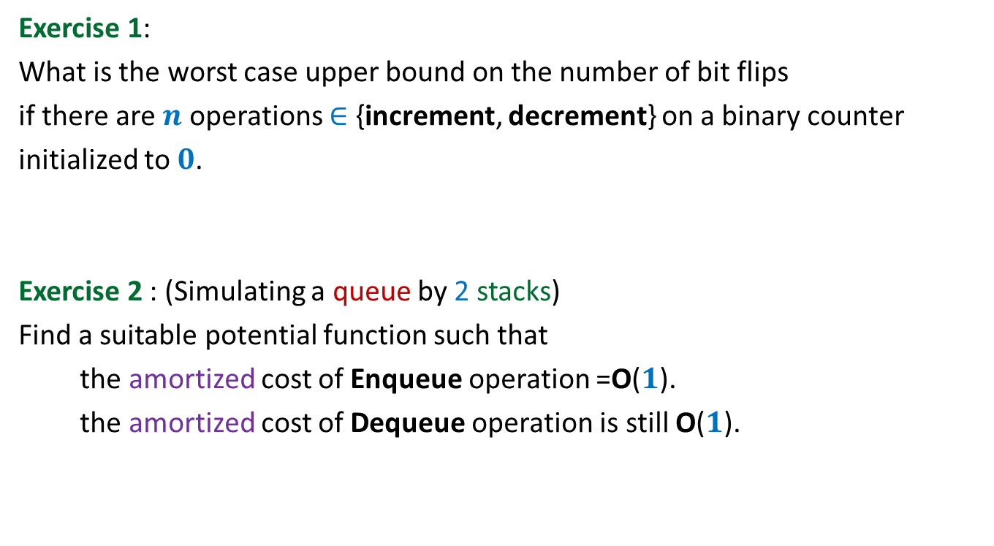
Home work Exercises
Exercise 1:
What is the worst case upper bound on the number of bit flips
if there are $n$ operations $∈$ {increment, decrement} on a binary counter
initialized to $0$.
Exercise 2 : (Simulating a queue by 2 stacks)
Find a suitable potential function such that
the amortized cost of Enqueue operation =O($1$).
the amortized cost of Dequeue operation is still O($1$).

Slide 36
Attention
A student suggested “size of Table” as a potential function. For the deletion operation, it leads to change in potential which nullify the actual cost. But it is not a valid potential function. This is because …
It is not 0 in the beginning.
[There is way to relax the condition “value 0 in the beginning” and arrive at an analysis of O(n) bound on n deletion operations. Basically you need to express the amortized cost of n operations in terms of the initial potential. You may think over it. However, it will not be considered as part of the syllabus. In all our analysis, we shall stick to the properties of the potential function defined in the previous class.]

